Slide 1
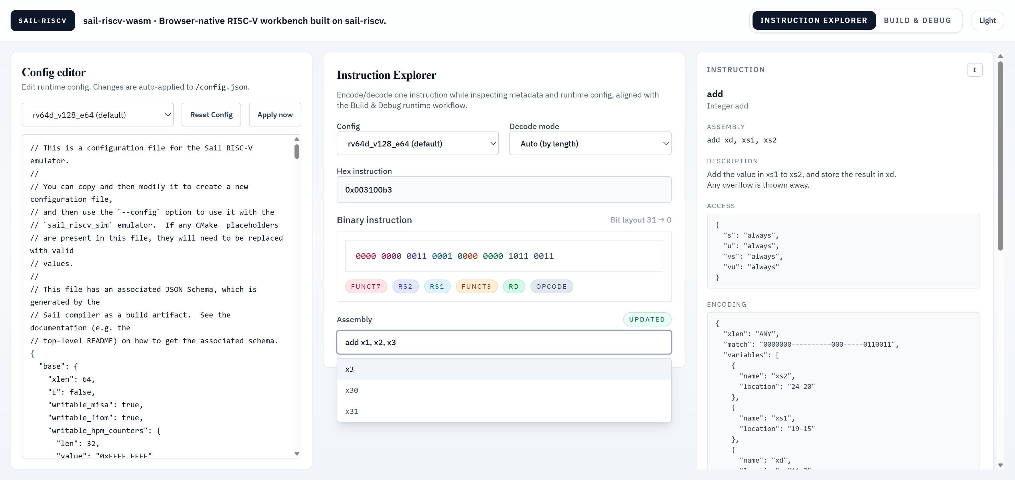
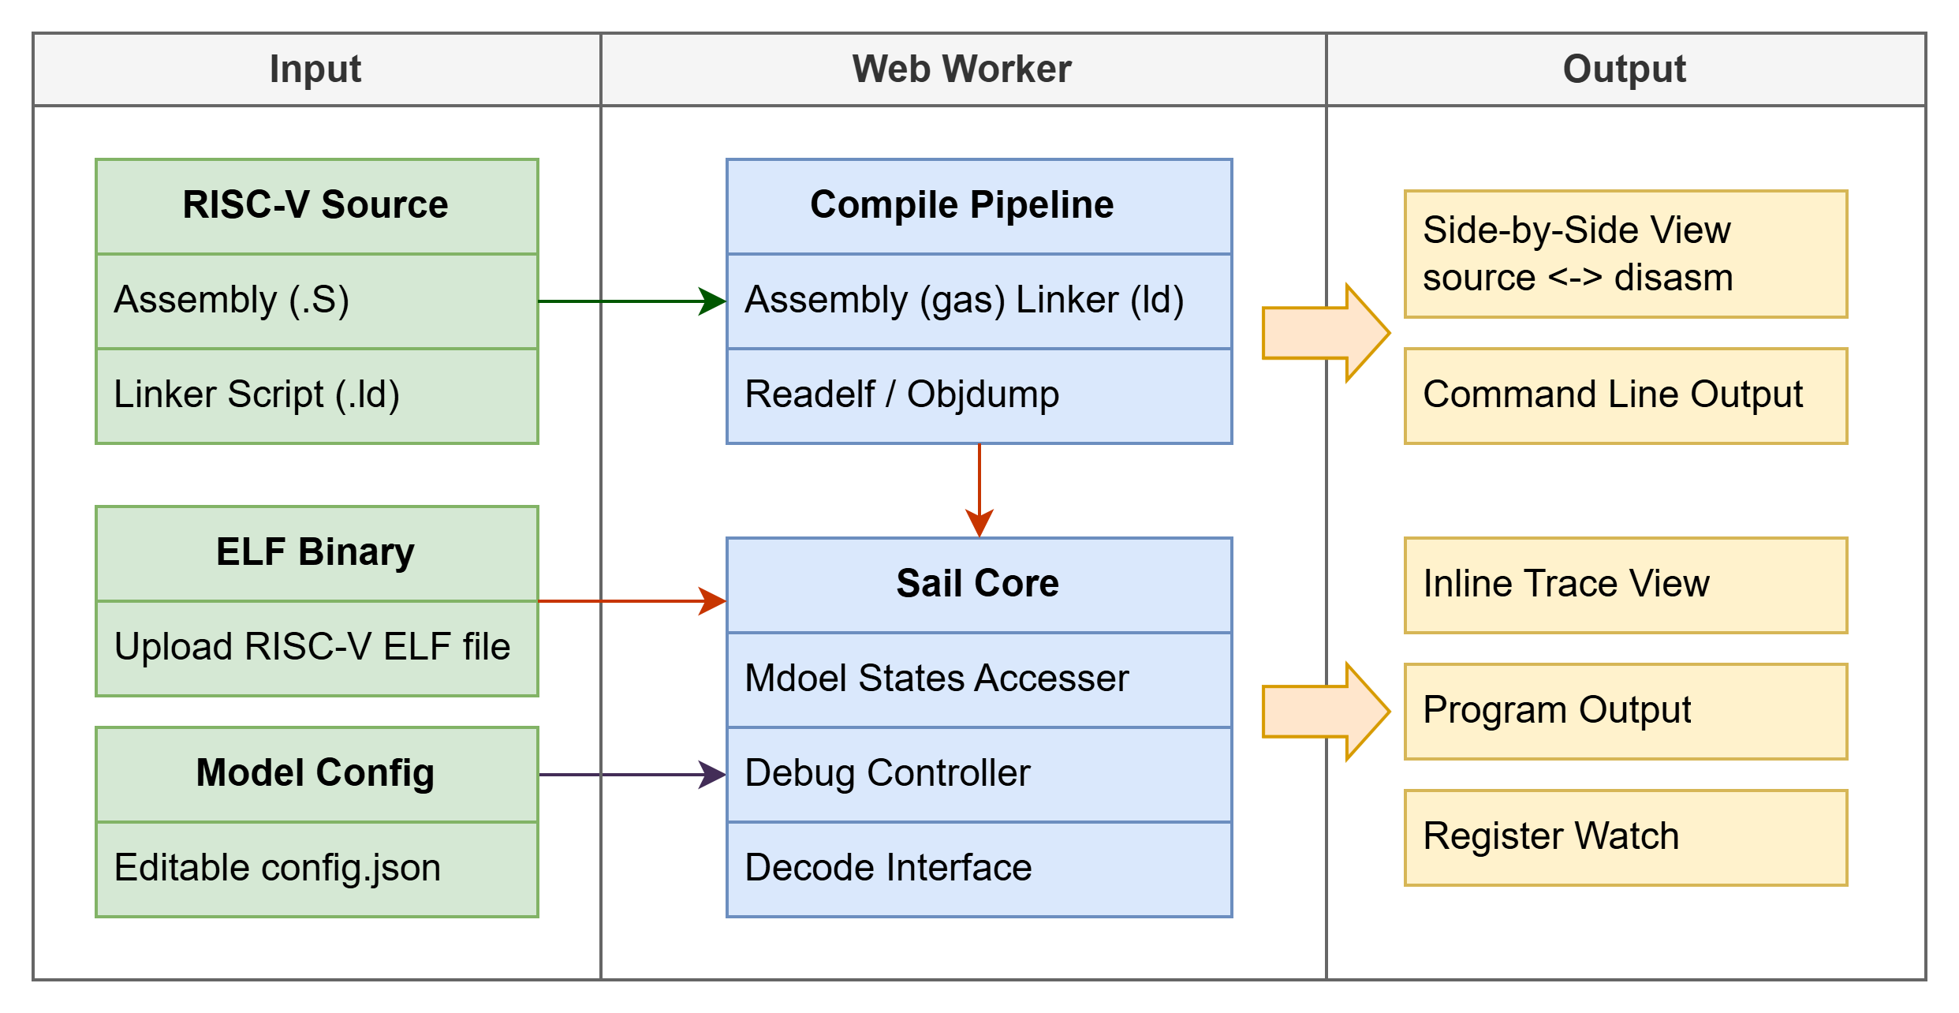
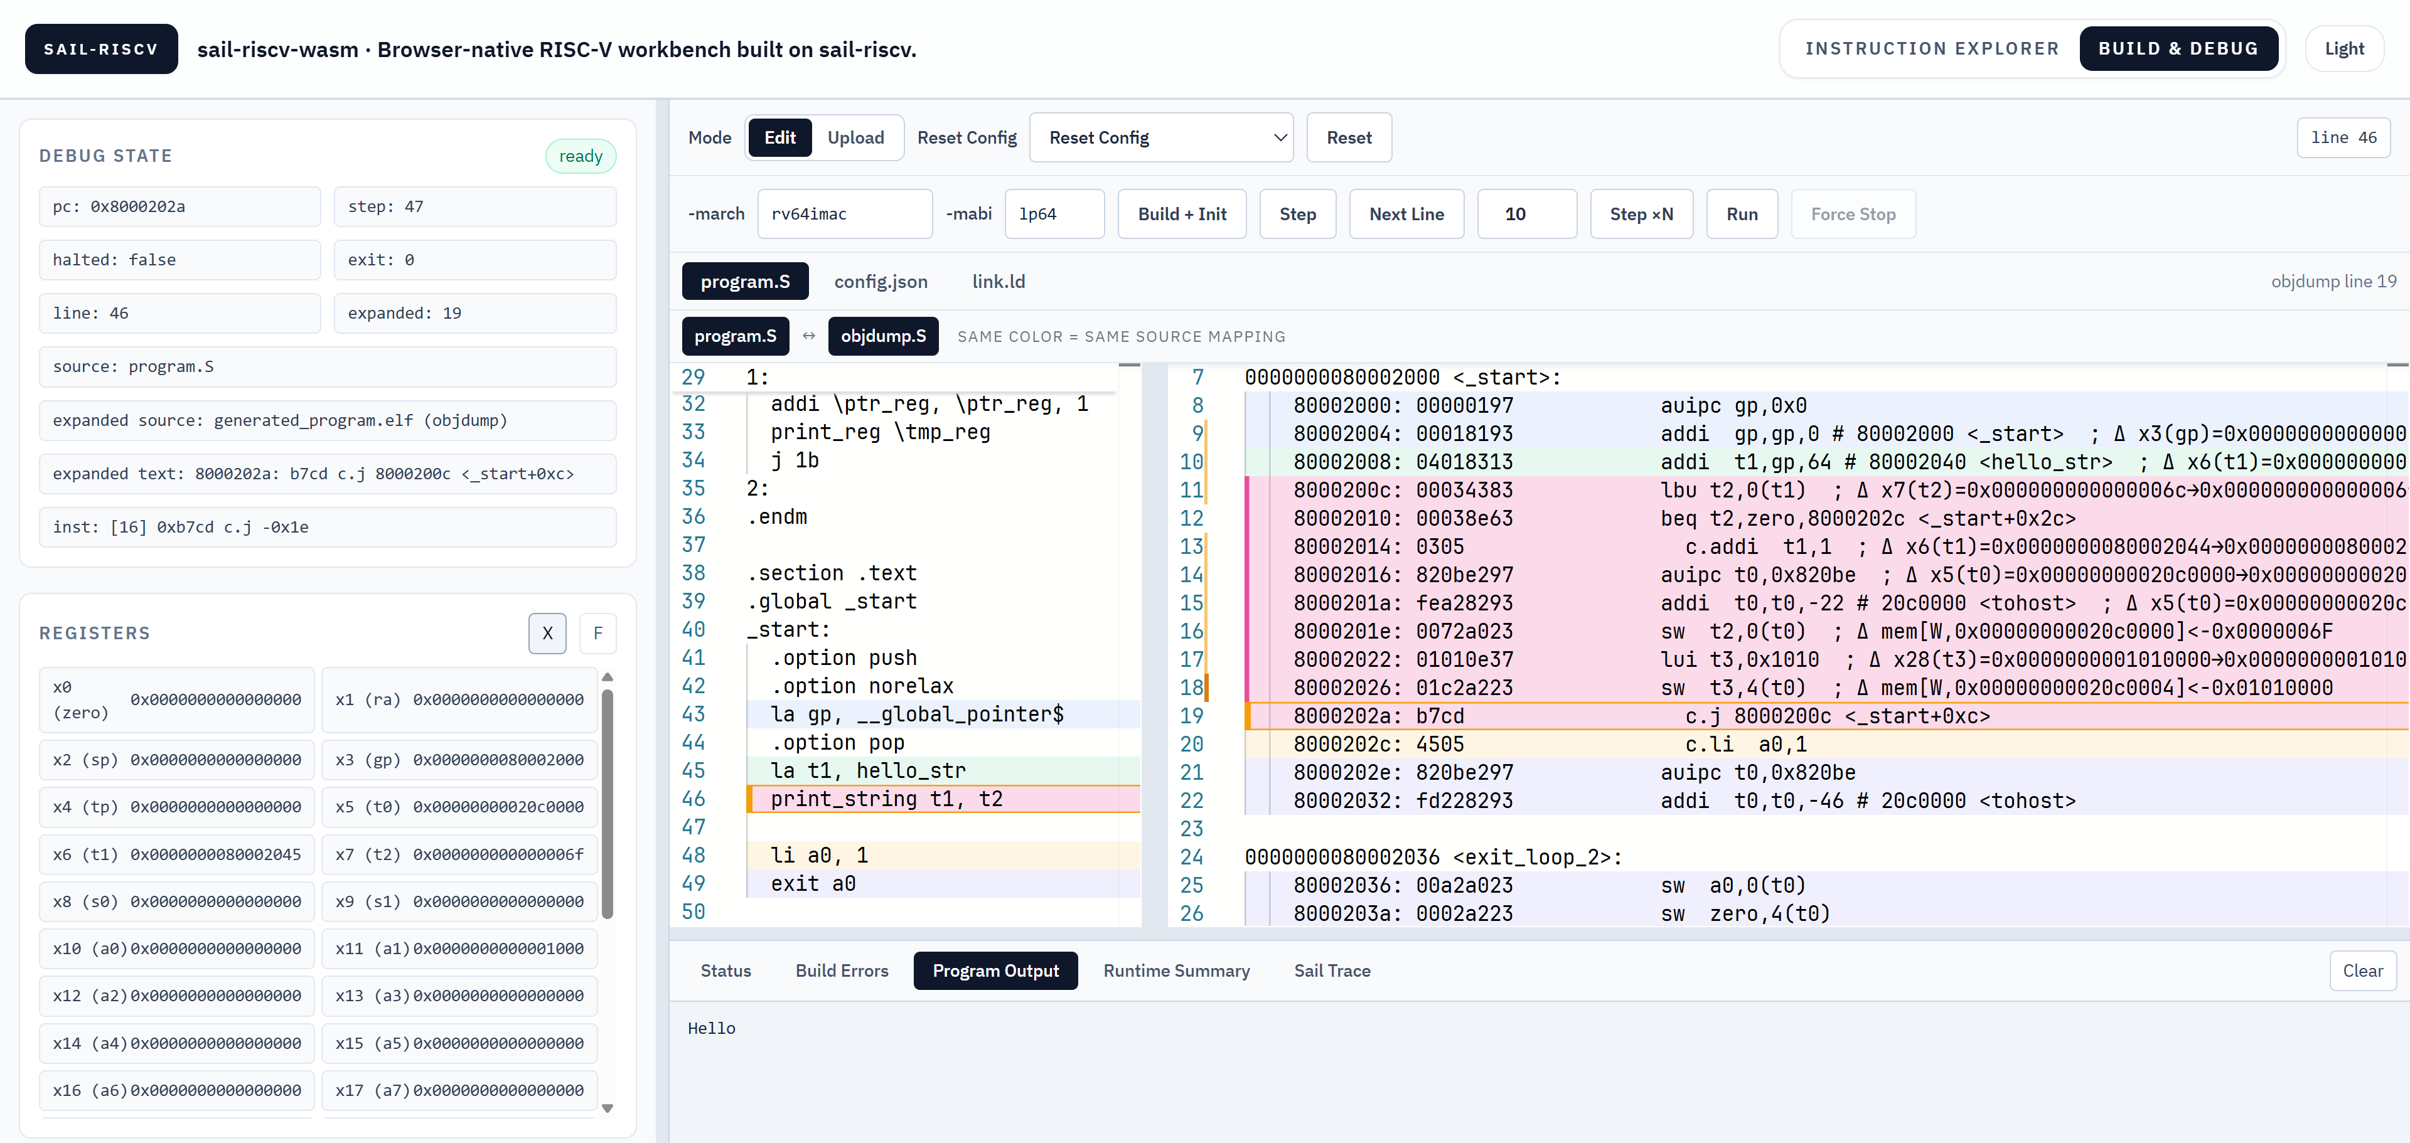


Sail-RISCV-WASM: A Browser-Native RISC-V
Toolchain and Debugging Workbench
Yanming Zhu¹, Yunxiang Luo¹
¹Intelligent Software Research Center, Institute of Software, Chinese Academy of Sciences
Motivation
Workflows
Browser-native delivery lowers the barrier to ISA tooling, but many browser tools still focus on only one use case. This leads to fragmented workflows, limited extension configurability, and weak linkage between source, execution, and diagnosis. Sail-RISCV-WASM addresses this gap with a single browser workspace for configuration-sensitive, in-browser build, execution, and interactive debugging for RISC-V. It is based on sail-riscv, with broad extension coverage and fine-grained configuration control.
Online Encode/Decode and Metadata Navigation The exploration workflow accepts binary, hex, or assembly input and normalizes it into a shared instruction state. The same page also serves as a lightweight instruction reference surface.
Method
This work contributes an end-to- end browser pipeline with no server-side execution plane, Sail-grounded decode and execute paths, broad extension coverage with fine-grained configuration switches, an in-browser source-to-ELF flow via gas/ld, and synchronized instruction-step/source-line-step debugging with register and memory traces.
Build, Execute, and Debug The runtime workflow supports editing assembly and linker scripts, building ELF binaries in-browser, and executing them in instruction-step or source-line-step mode. During stepping, the editor keeps source and disassembly synchronized and highlights mapped regions, while register and memory events appear in logs and inline annotations. The runtime page includes terminal-style output panes that aggregate logs in real time.
Encode/Decode/Execute We use Sail for encoding, decoding, and execution. The decoding process reads the user-provided JSON configuration (such as XLEN and extension enabling status), so the same machine code may decode to different results under different configurations.
Debug mapping and trace path Before debugging, the worker assembles and links source files into a debug-capable ELF, then extracts address-to-source-line and address-to-disassembly-line mappings.
WebWorker and browser debugging interfaces The system separates heavy computation from interactive control. The worker executes assembly, linking, disassembly, line mapping, and log aggregation. During runtime control, it calls browser-oriented debugging interfaces added around sail-riscv (session initialization, instruction-step, source-line-step, run, state readout, and reset). The frontend triggers these capabilities through a unified RPC surface and consumes structured debug-state updates.
Conclusion
Sail-RISCV-WASM provides an accessible and engineering-oriented RISC-V workflow: browser-native deployment, configuration-sensitive decode exploration, in-browser assembly and linking, synchronized source/disassembly stepping, and trace-driven diagnosis in one environment. Compared with common browser-only flows, it combines broader extension coverage and stronger configuration control in the same loop.
sail-riscv
source

